Slide 1

Labor Stability with wafla
A New Opportunity to Use the H-2A Program to Stabilize Your Workforce

Slide 2

Agenda
FELS strategic partnerships to support labor needs of all size farms
Who is wafla?
H-2A fundamentals
wafla’s high touch, quality H-2A filing and compliance services
FELS subscriber benefit
Request a consultation

Slide 3
wafla
Mission: Making labor stability a reality for all ag employers
Established in 2007 (Farm Bureau) to help growers use H-2A program
Non-profit business association representing agriculture
Member board of directors
Retained earnings go to member services, resources and advocacy
2023 H-2A business
292 H-2A contracts
17,995 worker requested
Contracts from 1 H-2A worker up to 3,000 H-2A workers
Primarily in Washington and Oregon (other western U.S. states)
Understand labor issues western ag employers face
Partnership with Harvust to digitally on-board H-2A workers

Slide 4
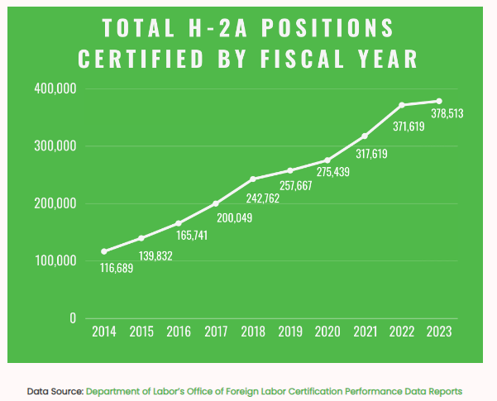

Slide 5
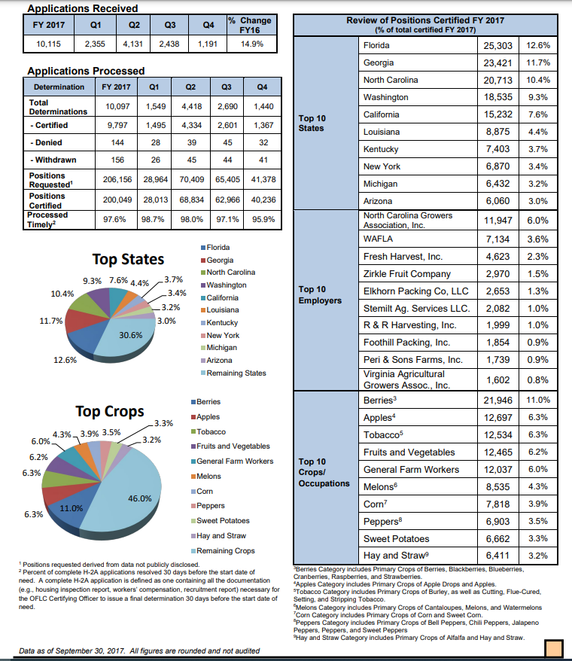
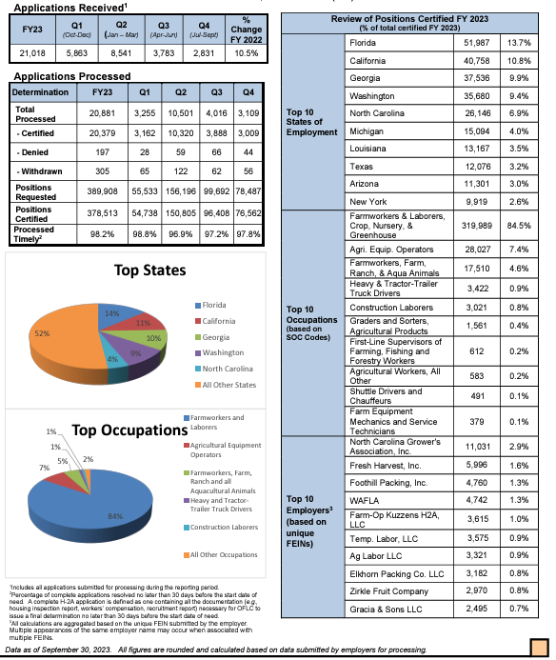

Slide 6

H-2A Fundamentals
Seasonal or temporary agricultural jobs – 10 months or less
Occupations
Farmworker
Equipment operator
Fresh produce sorter/packer
Truck drivers
Supervisors
Must actively recruit U.S. workers and hire through 50% of contract
Housing
Transportation to/from home country to farm
Pay H-2A and domestic workers highest of Adverse Effect Wage Rate (AEWR), prevailing wage, or piece rate wage
2024 AEWR CA = $19.75
3/4 guaranteed payment
No Social Security, Medicare taxes, or federal Unemployment
Work with 7 different state and federal agencies

Slide 7

Sounds easy enough, right?

Slide 8
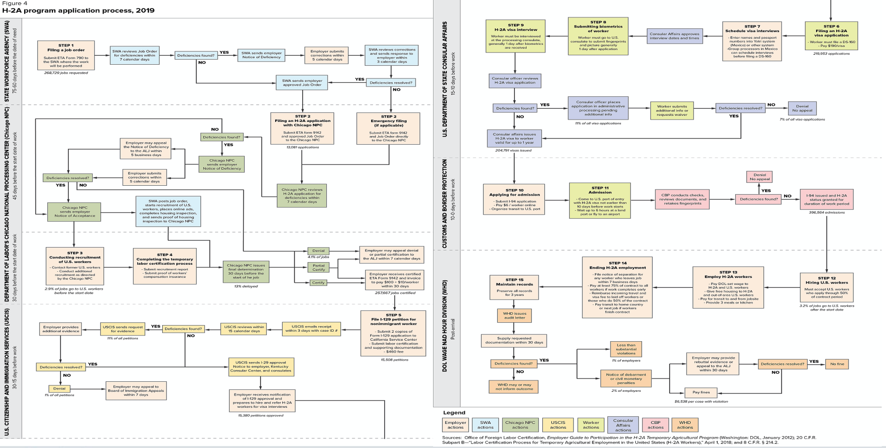

Slide 9
wafla’s high touch, quality services
STEP 1: Early, in-depth consultation with farmer
Understand unique issues with west coast labor-intensive ag
Define seasonal needs
Identify and consult on housing – inspection ready
Document job descriptions
Understand intersection of federal and state labor laws
Review human resource practices and areas for improvement
Education on H-2A technical rules and implementation

Slide 10
wafla’s high touch, quality services
STEP 2: Determine precise filing timeline
Wafla will pre-draft contract with information from step 1
Farmer will request housing inspection with wafla consultation
Wafla will file application with State Workforce Agency (SWA) 75-60 days before workers arrive
After SWA review,
Then Department of Labor review
Wafla will respond to any issues with application, work with farmer to answer SWA/DOL questions

Slide 11
wafla’s high touch, quality services
STEP 3: Recruit workers
Once application approved, SWA and wafla will advertise H-2A job contract
SWA posts job online
SWA places ads in local newspapers
Wafla can screen job candidates and referrals from state workforce services
Employer must hire qualified domestic workers
Wafla submits visa petition to USCIS
Wafla submits visa applications to U.S. Consulate and schedule appointments
Wafla ethically recruits international workers
Prohibited fees
Understand contract terms
Wafla handles logistics related to worker getting passport, staying in consulate city, and obtaining visas

Slide 12
wafla’s high touch, quality services
STEP 4: Transport of workers to farm and worker reimbursements
Wafla arranges for worker transportation from home – consulate – farm
Wafla calculates worker reimbursements and issues checks on farmer’s behalf
At farm within 1-2 business days prior to worker arrival
Farmer passes out checks to workers no later than before 50% time of contract completion

Slide 13
wafla’s high touch, quality services
STEP 5: Worker arrival and contract implementation
Wafla coaches farmer on receiving, welcoming workers
Wafla works with farmer to provide H-2A orientation to workers
Wafla provides farmer with pre-filled I-9s (pdf format)
Wafla serves as resource through contract to farmer and workers to issues
Understanding H-2A contract terms and conditions (wage and hour)
How to address productivity needs
Understanding worker rights
Understanding pay stubs
Working to resolve issues in-house
Wafla files any contract amendments or extensions
Wafla files worker abandonment reports
Wafla works with state and federal agencies on community outreach and compliance

Slide 14

wafla’s high touch, quality services
STEP 6: Worker finishes contract
Wafla calculates and issues worker outbound checks on farmer’s behalf
Arrive at farm 30-15 days prior to end of contract
Wafla holds end of season meeting with farmer to review contract and prepare for next year
Workers arrange their own transportation to go home at end of contract
In some cases, Wafla supports arranging for transportation of workers

Slide 15
wafla’s All-Inclusive services cater to smaller farmers

Slide 16
FELS Benefit – wafla All-Inclusive Plan
Membership: Free for FELS Subscribers ($300 annually)
Contract filing fee: $500 discount off 1st year filing
$250 discount off subsequent years
wafla Services:
Draft, submit and manage job order certification process.
Submit recruitment reports to DOL
File petition to USCIS for worker visas
Recruit foreign workers, schedule U.S. consulate appointments
Facilitate all worker transportation home country-to-farm-to-home country
Calculate and issue in-bound and out-bound worker checks
Assist with contract implementation, worker issues, and government audits
Maintain job certification filings and recruitment reports for 3-years
Legal counsel related to H-2A contract topics*
Employer may need additional resources and counsel (FELS services)
Collaboration with Harvust and Field Clock

Slide 17

Request a Consultation
Go to: wafla.org/h-2a/

