Slide 1
California’s New Workplace Violence Prevention Standard: August 23, 2024
Michele B. Miller
Elena K. Hillman

Slide 2


Today’s Presenters
Michele Ballard Miller mbmiller@cozen.com
Elena K. Hillman ehillman@cozen.com

Slide 3

California Workplace Violence Prevention Standard
Today’s Program:
Overview of SB 553
Covered employers and employees
The Workplace Violence Prevention Plan
Required training
Violent incident log
Best practices
SB 428: Temporary Restraining Orders

Slide 4
Overview of Standard

Slide 5
Workplace Violence Prevention Plans:
By July 1, 2024, covered employers must have established and provided initial training on a Workplace Violence Prevention Plan (WVPP) to their employees.
Must record information about every workplace violence incident in a violent incident log.
Must review plans and provide effective training.
The WVPP must conform with the requirements of new Labor Code Section 6401.9:
The plan must be written – it can be standalone or incorporated into an Injury and Illness Prevention Plan.
The plan must be easily accessible to employees, their authorized representatives, and Cal/OSHA representatives at all times.
Must be specific to the hazards and corrective measures for each work area and operation.
Employers must involve employees in creating and implementing the plan.

Slide 6
Covered Employers and Employees:
Applies to all employers (including the state and any subdivision of the state) with one or more employees, and all employees, places of employment, and employer-provided housing, except:
Health care facilities covered by the healthcare workplace violence regulations (8 Cal. Code Regs. § 3342) and other employers that comply with those standards.
Department of Corrections and Rehabilitation facilities.
Law Enforcement Agencies.
Employees teleworking from a location of the employee’s choice, which is not under the control of the employer.
Places of employment where there are fewer than 10 employees working at any given time and that are not accessible to the public if the location has a compliant Injury and Illness Prevention Plan (“IIPP”).

Slide 7

Defining Workplace Violence:
“Workplace violence” is any act of violence or threat of violence that occurs in a place of employment, including:
(i) The threat or use of physical force against an employee that results in, or has a high likelihood of resulting in, injury, psychological trauma, or stress, regardless of whether the employee sustains an injury.
(ii) An incident involving a threat or use of a firearm or other dangerous weapon, including the use of common objects as weapons, regardless of whether the employee sustains an injury.
Excluded from the definition: lawful acts of self-defense and defense of others that occur at a worksite.

Slide 8
Types of Workplace Violence:
Type 1: workplace violence committed by a person who has no legitimate business at the worksite and includes violent acts by anyone who enters the workplace or approaches workers with the intent to commit a crime.
Type 2: workplace violence directed at employees by customers, clients, patients, students, inmates, or visitors.
Type 3: workplace violence against an employee by a present or former employee, supervisor, or manager.
Type 4: workplace violence committed in the workplace by a person who does not work there but has or is known to have had a personal relationship with an employee.

Slide 9
Elements of the WVPP:
Required:
Name or job title of the person responsible for implementing the plan.
Effective procedures to obtain active involvement of employees and their representatives in developing and implementing the plan.
Methods to coordinate implementation of the plan with other employers and to ensure training of employees.
Effective procedures to accept and respond to reports of workplace violence.
Effective procedures to prohibit retaliation.

Slide 10
Elements of the WVPP:
Effective procedures to ensure compliance by all employees
Effective procedures to communicate with employees regarding workplace violence matters, including:
How to report workplace violence concerns to the employer or law enforcement
How reports will be investigated
How employees will be informed of results /corrective actions
Effective procedures to respond to actual or potential workplace violence emergencies
Methods to alert employees, evacuation or sheltering plans that are feasible for the worksite, and how to get help from staff or security

Slide 11

Elements of the WVPP:
Procedures to develop and provide training
Procedures to identify workplace violence hazards
Scheduled periodic inspections when the plan is first established, after each WV incident, and when the employer is made aware of a new or previously unrecognized hazard.
Procedures to correct workplace violence hazards in a timely manner
Procedures to review the effectiveness of the plan
Annually, when a deficiency is observed and after a WV incident

Slide 12

Additional Requirements:
Provide training to employees at least annually and retain records
Maintain records of workplace violence hazard identification, evaluation and correction
Record information in a violent incident log
Review the effectiveness of the plan and revise it as needed at least annually
Companies that are not in compliance can be cited by Cal/OSHA, and violations will include civil penalties and misdemeanors.

Slide 13
Required Training

Slide 14
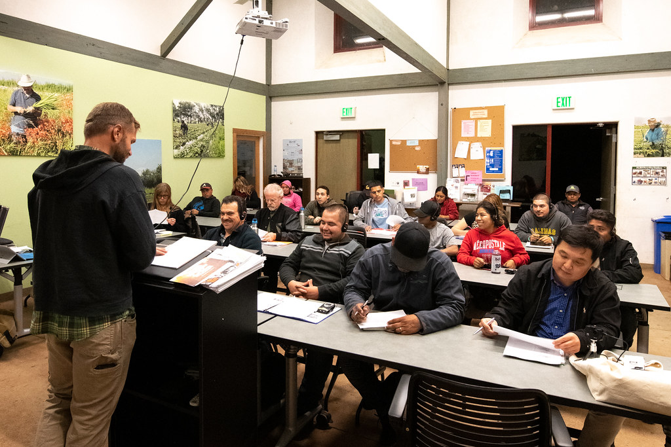
Effective Training:
When to train:
Initially when plan was first established (by July 1, 2024), and annually thereafter.
Initially upon hire.
When a new or previously unrecognized. workplace violence hazard has been identified in the workplace or specific to an employee’s job, or when changes are made to the plan.
Must be appropriate in content and vocabulary to the educational level, literacy, and language of .
An opportunity for interactive questions and answers with a knowledgeable person.

Slide 15
Required Subjects:
The employer’s plan and how to obtain a copy at no cost.
How employees can participate in plan development/implementation.
Definitions and requirements.
How to report workplace violence incidents or concerns.
Hazards particular to employee’s position.
Corrective measures implemented by employer, how to seek assistance to prevent/respond to violence, and strategies to avoid physical harm.
The violent incident log and how to obtain copies.
Records of training must be created and maintained for at least one year.

Slide 16
Violent Incident Log

Slide 17
Violent Incident Log:
Employers must record information in a violent incident log for every workplace violence incident.
Date, time and location of incident
Workplace violence type(s) (1-4, as defined by law)
Detailed description of the incident
Classification of who committed the violence
Classification of circumstances at time of the incident
Classification of where the incident occurred
Type of incident
Consequences of the incident
Information about the person completing the log
Must be maintained for a minimum of 5 years.
For multiemployer worksites, events must be recorded on a log by the employer whose employees experienced the workplace violence and a copy of the log provided to the controlling employer.

Slide 18

Other Required Records and Retention:
Records of workplace violence hazard identification, evaluation, and correction, for a minimum of five (5) years.
Workplace violence prevention plan training records for a minimum of one (1) year.
Violence Incident Logs for a minimum of five (5) years.
Records of workplace violence incident investigations for a minimum of five (5) years.
Cal/OSHA Form 300 for five (5) years.

Slide 19
What Should Employers Do to Prepare?

Slide 20
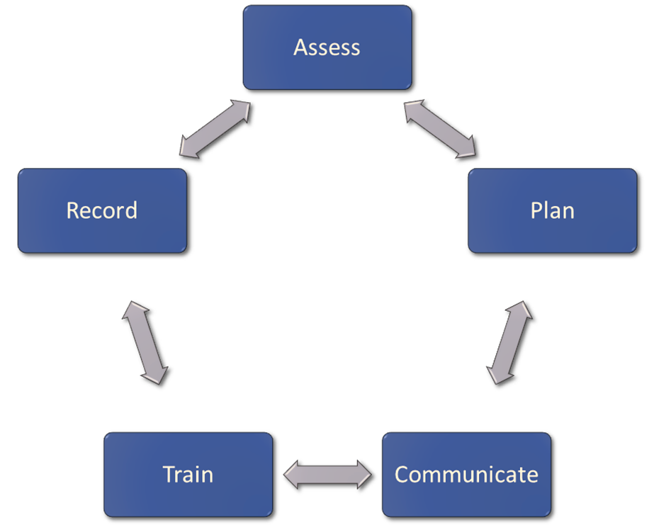
How Do You Reach Compliance?
Conduct a hazard assessment
Write the plan (use the Cal/OSHA Model Plan?)
Communicate with employees and get their input into hazards/the plan
Training programs
Create records & retention
This is a continual process, not a one-time compliance check.

Slide 21

Assess:
Whether you conduct an internal assessment or use a third-party, employees familiar with the work location and hazards and threats at that work location must be included in the assessment.
Assess your work locations to identify hazards at each location.
Identify human caused threats and hazards
Understand facility and site access control for employees
Determine private, public & restricted areas
Visitor management protocols
Crime prevention through environmental design
Emergency communication systems and protocols
Consider ADA and other compliance factors
Assess on a regular basis (annually), after an incident or when you learn of a new hazard applicable to the workplace or to areas or positions in the workplace.

Slide 22

Plan:
Who is responsible for the written plan/training protocols?
Identify a cross-functional team to develop the plan to understand diverse work locations and employee needs.
Define other roles and responsibilities for plan development, maintenance, implementation and compliance.
Adopt a framework that aligns with company plans (renovation, relocation, expansion/contraction, etc.)
Define key terms used in the policy ex: Workplace Violence, Victim, Threat, Implied Threat, Domestic Violence, Active Shooter, Employee Representative, etc.
Develop communication protocols for employees to report incidents of WPV and actual/potential threats, as well as guidance for when to escalate/contact law enforcement.

Slide 23

Communicate:
Communicate the plan to all work locations and sites using a multi-modal communication strategy.
Explain in detail how the business will respond to threats and/or reports of workplace violence.
Detail how you mitigate and correct hazards.
Explain the training and notification process as outlined in the plan.
Describe the employee’s role in prevention and reporting.

Slide 24

Train:
Situational awareness
Identifying suspicious activity and pre-violence indicators
De-escalation & disengagement
Immediate actions (Run | Hide | Fight)
Communication protocols
When to contact law enforcement or other WPV team members
Utilize all communication systems (Intranet postings, lecture based, LMS, etc.) Must contain Q&A.
Reminder: Your training must be communicated based on literacy and primary language of employees
Instructors or leaders should know the plan and be able to provide answers in a reasonable time frame.

Slide 25
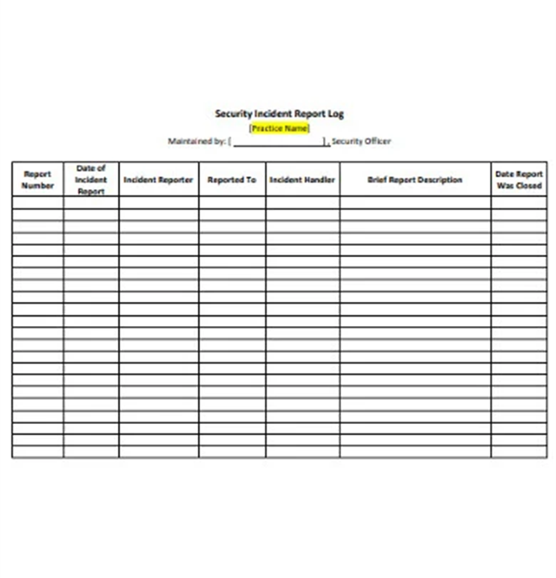
Record:
Required to track incidents of violence, threats and investigations.
Case documentation (assignment).
Reporting mechanisms.
Team review & improvement plan.
Each report should be reviewed by HR, the team leader and others necessary to make informed decisions.
After any report, a thorough After-Action Review should be completed and any preventative or mitigation steps implemented and identified.
Assign the violent incident log record keeping to a primary and secondary position.
Keep records accessible and current.

Slide 26
Temporary Restraining Orders

Slide 27
Workplace Violence Restraining Orders:
California law currently enables employers to seek a temporary restraining order against any individual who has engaged in workplace violence or threats of violence
Filed by the employer
To protect employees and their immediate family members
May include these types of orders
No contact
Not harass, stalk, threaten, or harm people protected by the order
Stay away from people protected by the order, and the workplace
Cannot own or have firearms or ammunition
Transmitted to law enforcement

Slide 28
Workplace Violence Restraining Order:
An employee has suffered “unlawful violence” or “a credible threat of violence.”
Unlawful violence: any assault or battery, or stalking (but not self-defense or defense of others).
Credible threat of violence: “a knowing and willful statement or course of conduct that would place a reasonable person in fear for his or her safety, or the safety of his or her immediate family, and that serves no legitimate purpose.”
From any individual, that can reasonably be construed to be carried out or to have been carried out at the workplace.
Reasonable proof (TRO).
Clear and convincing evidence (further order).

Slide 29

Workplace Violence Restraining Orders:
Effective January 1, 2025, a collective bargaining representative will be able to seek a restraining order on behalf of employees who suffer unlawful violence or a credible threat of violence that can reasonably be construed to have been carried out at the workplace.
Effective January 1, 2025, employers or collective bargaining representative will also be able to seek TRO for employees who have suffered “harassment,” as defined.
“Harassment” is a knowing and willful course of conduct directed at a specific person that seriously alarms, annoys, or harasses the person, and that serves no legitimate purpose.
The course of conduct must be that which would cause a reasonable person to suffer substantial emotional distress, and actually does cause substantial emotional distress.
Employers or collective bargaining representative shall provide the employee who has suffered harassment, unlawful violence, or a credible threat of violence from any individual, an opportunity to decline to be named.
This Photo by Unknown Author is licensed under CC BY-SA

Slide 30
Resources
Cal/OSHA Fact Sheet for Agricultural Employers: https://www.dir.ca.gov/dosh/dosh_publications/WPV-Agriculture-for-employers-fs.pdf
Cal/OSHA Model Plan: https://www.dir.ca.gov/dosh/PubOrder.asp#WVP
Cal/OSHA FAQs: https://www.dir.ca.gov/dosh/Workplace-Violence/FAQ.html

Slide 31


