Slide 1

Cal/OSHA
Avian Influenza (Bird Flu) &
Worker Protection
Title 8 Section 5199.1 Aerosol Transmissible Diseases – Zoonotic

Slide 2
Cal/OSHA
  Cal/OSHA protects and improves the health and safety of all working persons in California by:
    Creating and enforcing safety and health regulations for workers
    Providing outreach, education, and assistance
  Cal/OSHA protects all workers in California regardless of immigration status
  Cal/OSHA does not ask about a worker's immigration status
  Cal/OSHA does not enforce immigration laws and will not report anyone to US Immigrations and Customs Enforcement (ICE)

Slide 3
Title 8 Section 5199.1
Aerosol Transmissible Disease – Zoonotic
5199.1 is the law that protects workers from diseases that:
  Come from animals (zoonotic), and
  Can infect persons through splashes or through the air (aerosol)
  The law applies in most workplaces where there are animals or unprocessed animal products, such as:
  Animal farms, slaughterhouses, zoos, veterinary clinics, jobs that handle wildlife, etc.

Slide 4
Base Requirements of 5199.1
5199.1(a) Requirements for employers:
  Have written instructions and rules for protecting employees from diseases that come from animals
  Instructions and rules must include sanitation, illness investigation, training, biosecurity, and use of personal protective equipment (PPE)
    Employer must provide employee training that covers these topics
    Employer must maintain records of how they comply with the law

Slide 5
Additional Requirements of 5199.1
Additional requirements for dairies and animal farms with:
  5199.1(c) USDA or CDFA quarantine order, movement restrictions, or infection control order
      and
  5199.1(d) Infected animals & wastes, and areas used to contain infected animals or wastes
  Part (c) can apply even if there are no infected animals
  Both requirements (c) and (d) apply to cattle herds, poultry farms, and any other farms/ranches with animals infected by H5N1

Slide 6
Requirements – USDA or CDFA quarantine or infection control order
Even if there are no infected animals
  Employers must:
  Have detailed written instructions and rules on how to work safely
  Set up restricted areas where exposure to animal diseases could occur
  Post signs at all entrances to restricted areas. Signs must:
  Identify areas as restricted areas
  Be in all languages spoken by workers
5199.1(c)

Slide 7
Requirements – USDA or CDFA quarantine or infection control order
Even if there are no infected animals
  A supervisor knowledgeable in the dairy’s written safety instructions and rules must oversee employees in restricted areas
  In restricted areas, the employer must provide and ensure use of personal protective equipment and clothing (PPE):
    Full-body coveralls, head coverings, gloves, mouth/nose protection
    Eye protection
    Respirators indoors or other enclosed areas where there are potentially infectious aerosols (splashes, droplets, mists, dust, tiny particles, etc.)
  The employer must provide and ensure access to change rooms, shower rooms, restrooms, and drinking water
5199.1(c)

Slide 8
Requirements – USDA or CDFA quarantine or infection control order
Even if there are no infected animals
  Additional requirements for restricted areas:
  Employers must provide employees who enter these areas with:
    Medical services, health checks, vaccinations, medications – as recommended by CDC, CDPH, or Local Health Officer
    Training – animal disease hazards, protective measures, PPE, respirators, decontamination, medical services, health checks, vaccinations, medications, heat illness prevention
      Training must be appropriate for employees’ level of education, literacy, and language
5199.1(c)

Slide 9
5199.1(d) Handling infected animals
Cleaning and disinfecting areas that contained infected animals or wastes
  More protective & detailed than 5199(c)
  Applies to:
  Handling, culling, transporting, killing, eradicating, or disposing of infected animals
  Cleaning & disinfecting of areas used, or previously used, to contain infected animals or their wastes
  Cattle herds/dairies & poultry farms with animals infected by H5N1
5199.1(d)

Slide 10
5199.1(d) Handling infected animals
Cleaning and disinfecting areas that contained infected animals or wastes
  Employers must:
  Have written safety instructions and rules
    Make them available to employees onsite
  Workplan:
    Risk assessment for biological, chemical, physical, and safety hazards
    Description of protective measures
    Designate restricted areas
  List all jobs, tasks, or procedures with employee exposure
5199.1(d)

Slide 11
5199.1(d) Handling infected animals
Cleaning and disinfecting areas that contained infected animals or wastes
  Written procedures – measures to control employee exposure:
  Protective measures (engineering controls, work practice controls)
  Instructions and rules for safe handling of hazardous chemicals
  Respiratory protection
  Personal protective equipment and clothing (PPE)
  Decontamination instructions and rules
5199.1(d)

Slide 12
5199.1(d) Handling infected animals
Cleaning and disinfecting areas that contained infected animals or wastes
  Written procedures – measures to control employee exposure:
  Disposal of animal waste and contaminated PPE
  Medical services
  Training
  Recordkeeping
5199.1(d)

Slide 13
5199.1(d) Handling infected animals
Cleaning and disinfecting areas that contained infected animals or wastes
  Supervision:
  Person knowledgeable of employer's safety instructions and rules must supervise and enforce rules in the restricted area
  Ensure only trained persons enter restricted area
  Record name, entry time, and exit time for each person who enters and/or exits restricted area
  Ensure correct PPE and respirators are used
5199.1(d)

Slide 14
5199.1(d) Handling infected animals
Cleaning and disinfecting areas that contained infected animals or wastes
  Respiratory protection:
  Required in restricted areas until area is made safe from animal diseases
  Enclosed areas: employees must use elastomeric (rubbery) respirators or powered air purifying respirators (Do not use N95s or filtering facepiece respirators)
  Outdoors: employees must use N95 or better respirator
5199.1(d)

Slide 15
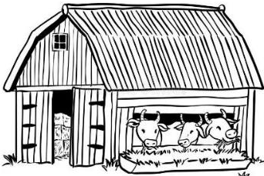
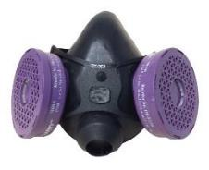
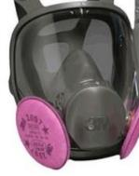
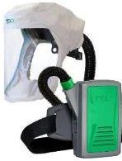
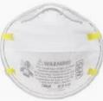

5199.1(d) Handling infected animals
Cleaning and disinfecting areas that contained infected animals or wastes
  Respiratory Protection:
  Respirators for enclosed areas – must be elastomeric or PAPR
Do not use N95s in enclosed areas
5199.1(d)

Slide 16

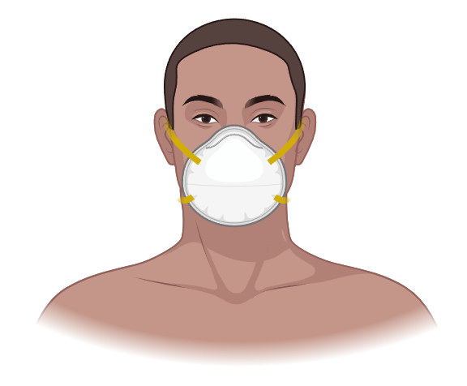
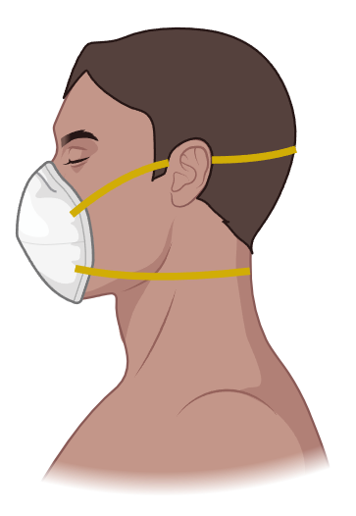

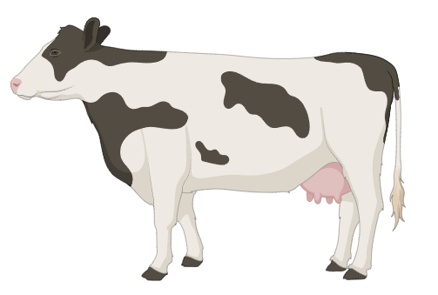

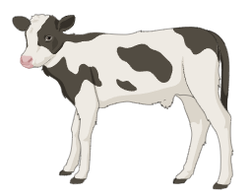
5199.1(d) Handling infected animals
Cleaning and disinfecting areas that contained infected animals or wastes
  Respiratory protection:
  N95s or better are okay outdoors
5199.1(d)

Slide 17
5199.1(d) Handling infected animals
Cleaning and disinfecting areas that contained infected animals or wastes
  Decontamination:
  Employers must ensure:
    Employees properly decontaminate when leaving restricted areas
    Contaminated clothing and equipment are decontaminated or disposed of
  Decontamination facilities must include change rooms and shower facilities
5199.1(d)

Slide 18
5199.1(d) Handling infected animals
Cleaning and disinfecting areas that contained infected animals or wastes
  Medical Services:
  Employers must establish a medical services program for employees who enter restricted areas:
    In developing the program, employers must consult with a physician or other licensed healthcare professional (PLHCP) knowledgeable about zoonotic disease and chemical hazards
    The program must maintain medical confidentiality
5199.1(d)

Slide 19
5199.1(d) Handling infected animals
Cleaning and disinfecting areas that contained infected animals or wastes
  Additional medical services:
  For each employee, employer must provide:
    Initial medical evaluation prior to entry into restricted area
    All vaccinations, prophylaxis, and medical surveillance recommended by PLHCP, CDC, CDPH, or local health officer
    Follow-up medical evaluations as recommended by PLHCP, CDC, CDPH, or local health officer
5199.1(d)

Slide 20
5199.1(d) Handling infected animals
Cleaning and disinfecting areas that contained infected animals or wastes
  Additional medical services:
  PLHCP prepares written report to employer for each employee with only:
    Respirator medical evaluation
    Whether employee received exams, vaccines, and/or prophylaxis
    Authorization for employee to work in restricted area
5199.1(d)

Slide 21
5199.1(d) Handling infected animals
Cleaning and disinfecting areas that contained infected animals or wastes
  Training:
  Provide upon:
    Initial assignment
    When site conditions change substantially
    When new hazards are introduced or recognized
  Must be appropriate for employees’ level of education, literacy, and language
5199.1(d)

Slide 22
5199.1(d) Handling infected animals
Cleaning and disinfecting areas that contained infected animals or wastes
  Training must cover:
  Identification, description, signs, and symptoms of zoonotic diseases
  Processes and procedures to use in restricted areas and when handling infected animals and their waste
5199.1(d)

Slide 23
5199.1(d) Handling infected animals
Cleaning and disinfecting areas that contained infected animals or wastes
  Training must cover:
  Employer's safety program:
    Engineering and administrative controls
    Exposure monitoring and results of exposure monitoring
    Use of respiratory protection and PPE
    Cleaning and decontamination procedures
5199.1(d)

Slide 24
5199.1(d) Handling infected animals
Cleaning and disinfecting areas that contained infected animals or wastes
  Training must cover:
  Employer's safety program:
    Access to sanitation facilities and drinking water
    Meaning of signs that will be used onsite
    Hazard communications – chemicals
    Employer’s medical services program
5199.1(d)

Slide 25

Resources
Cal/OSHA guidance on avian flu
  Protection from avian influenza webpage with info for employers and workers: www.dir.ca.gov/dosh/avian-flu/

Slide 26

Resources
Cal/OSHA guidance on avian flu
  Workplace safety and health guide on zoonotic aerosol transmissible disease standards: www.dir.ca.gov/dosh/dosh_publications/Zoonotic-ATD-Hazards.pdf

Slide 27

Resources
Cal/OSHA guidance on avian flu
  Model injury and illness prevention program to address zoonotic hazards for employers: www.dir.ca.gov/dosh/dosh_publications/Model-IIPP-Zoonotic.docx

Slide 28

Cal/OSHA Consultation Services
  Free for the employer community
  No fines, penalties, or citations issued
  Consultation does not share with Cal/OSHA Enforcement
  The consultation is confidential
  Employer receives a written report summarizing the consultation evaluation
    The written report is not a citation
  More information: Call 1-800-963-9424 or visit us online at www.dir.ca.gov/dosh/consultation.html

Slide 29
Workers’ compensation
  Employers must provide workers’ compensation benefits for workers who get bird flu on the job
  Unlikely to get bird flu from another person
  Employees exposed to animals on the job can likely prove that their illness is from work, unless they were exposed to bird flu away from work
  Workers’ compensation benefits include:
  Medical Care – employer pays all reasonable and necessary treatment
  Temporary Disability Benefits – employer pays portion of lost wages if employees misses three or more days of work because of the illness
  Permanent disability benefits – if illness causes permanent impairment

Slide 30

Workers’ compensation
  For more information:
  Division of Workers’ Compensation: 1-800-736-7401
  FAQs: https://www.dir.ca.gov/dwc/DWC_FAQ.htm (in English and Spanish)

Slide 31

Paid sick leave
  Employers are required to provide paid sick leave
  Employers must allow an employee to use up to 40 hours or five days, whichever is more, of earned paid sick leave in a 12-month period
  To qualify for paid sick leave, employees must have:
    Worked at least 30 days for the same employer in a year
  An employee is entitled to use what they have earned on the 90th day of employment, although an employer can lend paid sick leave in advance of accrual.
  More information: https://www.dir.ca.gov/dlse/California-Paid-Sick-Leave.html (available in English and Spanish)

